Slide 1


Free software for home users
AccessAbility Solutions
AccessAbility Solutions
to help your son/daughter
Sheldon Conference 24th November 2012

Slide 2
Contact Details
AccessAbility Solutions
AccessAbility Solutions
myles.pilling@wiltshire.gov.uk
Twitter: @mylespilling
#sheldenbda
http://senitnuggets.wordpress.com
http://senapps.wordpress.com
http://www.facebook.com/Senapps
http://aas123.wordpress.com

Slide 3

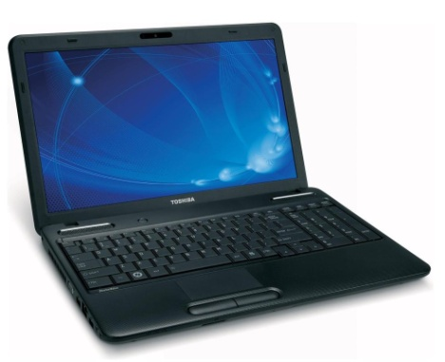




What shall we cover?
Free stuff to use on a PC
Free stuff to use on an Apple
Free stuff from the Internet
Changes to your PC making it Dyslexia friendly

Slide 4
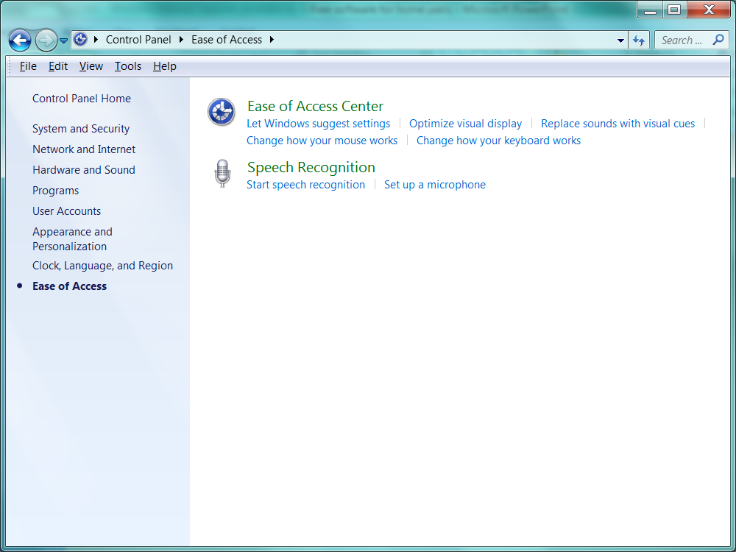
Changes to your PC
Style sheets
Backgrounds
Templates
Line Spacing
Speech recognition
in Windows 7
Ease of Access Center – Key repeat

Slide 5

Free Stuff for your PC
http://www.gingersoftware.com/

Slide 6
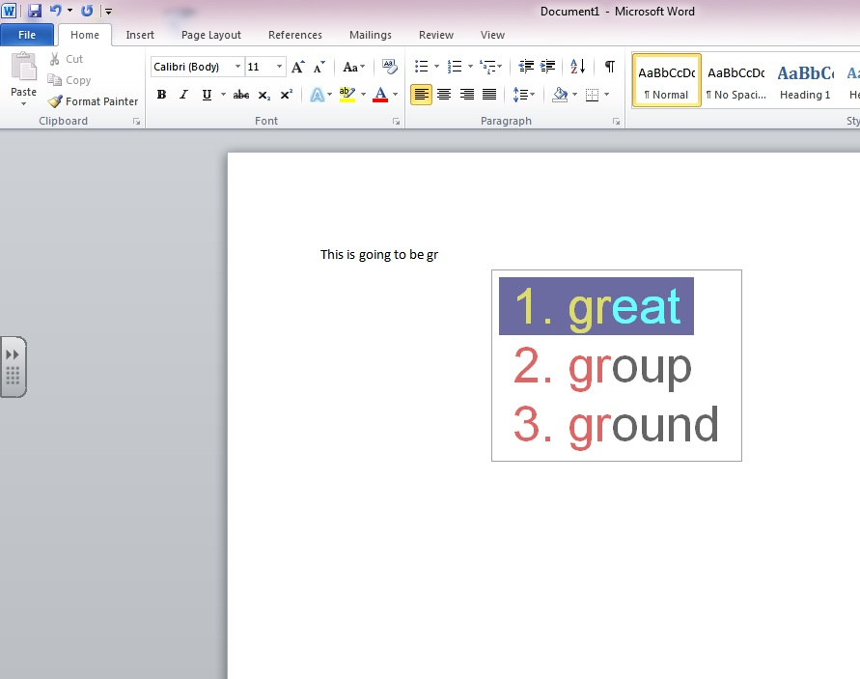
Free stuff for your PC
Turbo Type
http://www.easytousetools.com/turbo_type/

Slide 7
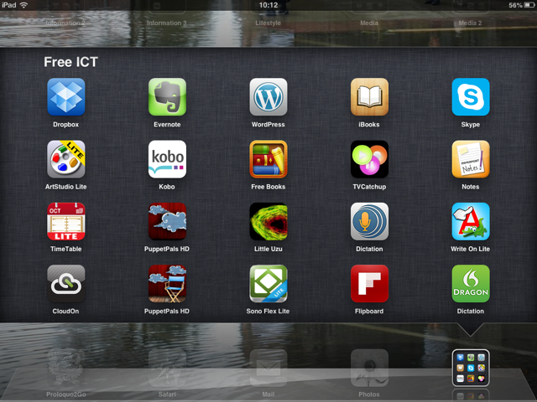
Free apps for your iPad/iTouch

Slide 8
Free apps for your iPad/iTouch
Cloud On
Dragon
Art Studio Lite
Notes
Evernote
Dropbox

Slide 9

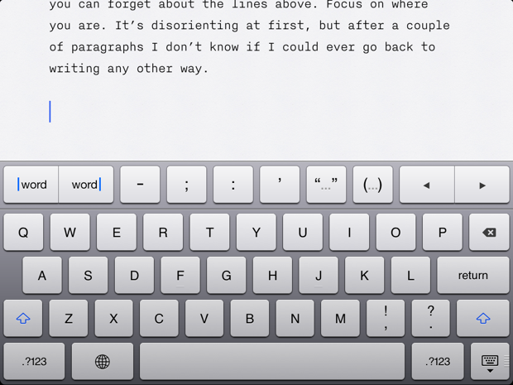
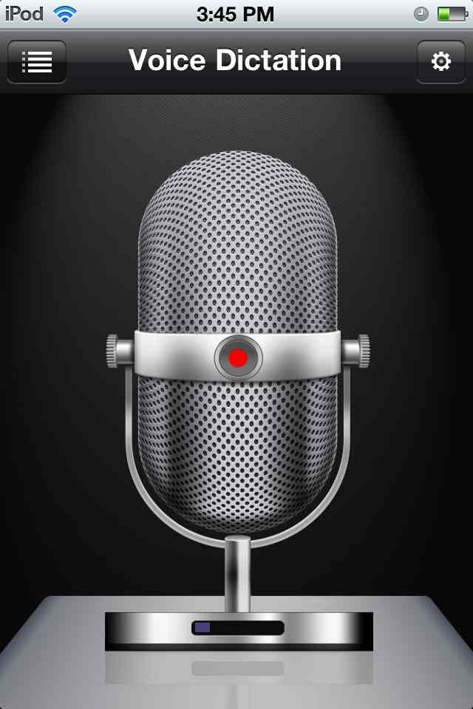

Not free apps
iWriter - £2.49
Voice Dictation - £0.69

Slide 10
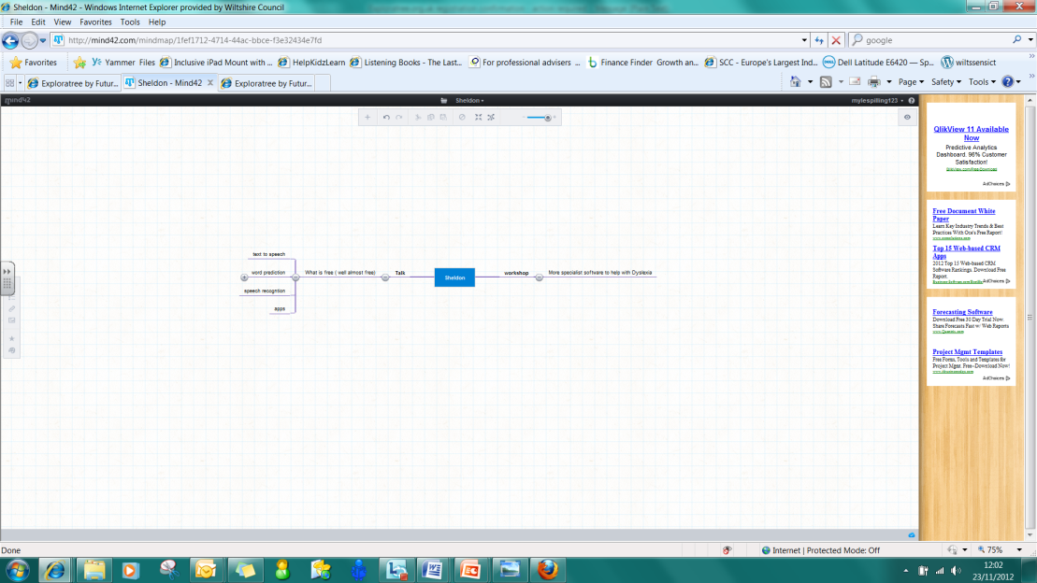
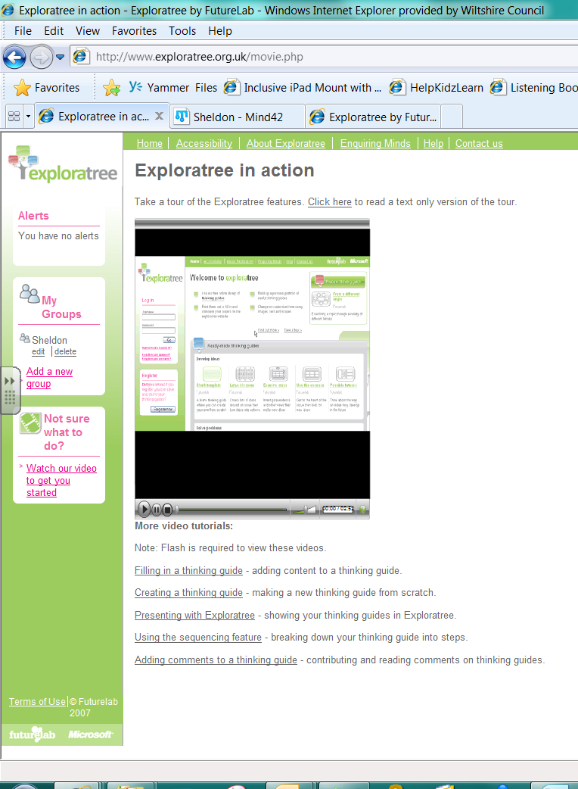
Free Stuff from the Internet
Mind- mapping software
Mind42
http://mind42.com/about
Exploratree
http://www.exploratree.org.uk
http://www.exploratree.org.uk/movie.php

Slide 11
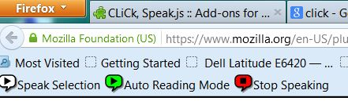
Click and speak
( for firefox web browser)
http://clickspeak.clcworld.net/downloads.html

Slide 12
Contact Details
AccessAbility Solutions
AccessAbility Solutions
myles.pilling@wiltshire.gov.uk
Twitter: @mylespilling
#sheldenbda
http://senitnuggets.wordpress.com
http://senapps.wordpress.com
http://www.facebook.com/Senapps
http://aas123.wordpress.com

